Slide 1
Beyond EDR

Slide 2
What We Do
The main damage is the spreading of cyber-attacks across the organization
We completely prevent this
spreading
​including new and unknown ones
within and outside the organizational network

Slide 3
Too Many Parallel Services
Other Cyber Companies
EDR, XDR, MDR, Monitoring, IDS, IPS, NAC
Weaknesses Identification, IR, SOC, Vlans
Consulting Services, Forensics, Gateway
DDos protection, Next Gen Antivirus, Vaults
Network Mapping, Data Recovery, Phishing
Penetration Test, Events Analysis, Sandbox
Spam, floodgates, proxies, Safebox, Firewall Next-Generation Firewall Packet Filter,
Circuit-Level Gateway, Stateful Application Firewall, Application-Level Threat-Focused NGFW……..…
Too many reports. Too many false positives
prevents the spreading of Cyber-attacks
and solves the most important problem
Focuses only on that
and does it better than any other Cyber company
Sends only the list
of software that it blocks
You don’t need more than that !!

Slide 4
How Other Companies Act
Detection
Prevention
First they try to detect and recognize
every malicious software
Then try to prevent its spreading
within the organizational network
They can’t really solve the problem
They can’t ensure 100% Prevention
they can’t prevent the spreading of
any malware that they didn’t detect
Hackers can remove the defense systems
They can’t ensure 100% Detection
New malicious software every second

Slide 5
Cyber 2.0 is Beyond EDR
Detection
Total Prevention
Doesn’t miss any new
cyber-attack
The system continues protecting even if being removed
The technology: Zero Trust
The technology: Chaos Algorithm

Slide 6
The Chaos Model
The Cyber World
is based on
biological models
is based on
mathematical chaos model
that are vulnerable to attacks
by systems using similar models (hence where the terminology virus and anti-virus comes from)
that can’t be breached
(Not even by us)
Video
Cyber 2.0 is protected by 9 patents

Slide 7
Challenging all Hackers
5 years
8,000 hackers
$ 100,000 Reward
They all failed

Slide 8
Among our Customers
Ports: The Israeli largest port. POC in Barcelona,
Water Systems: The National water company of Israel+ 60% of the regional water systems
Army: The Israeli Navy
Industries, corporates
Hospitals: The largest hospital in Israel+ 18 hospitals in India
Airports: POC in Kentucky USA
security industries: The largest producer of engines for aircrafts
Power and electricity companies

Slide 9
Our Detection- Doesn't Miss Any New Attack
Maps All Activities in the Organization
Every process and every library file that loads is recorded
Monitor Mode
The system takes their MD5 and SHA signature
Every access of a process to another process is recorded

Slide 10
Our Detection (2) - Zero Trust
Installed - 3,000
Maps all active software (2000)
Removes/blocks malicious (50)
Reflects unknown (100)
approves (850)
Moves to Defense-Mode and blocks all the rest (including every new software and virus, every 0-Day and every dormant software)
Active – 2,000
Uses network resources- 1,000
Unknown 100
malicious
50
IT manager gets the whole service from Cyber 2.0

Slide 11
Our Prevention - Continues protecting
The technology: Chaos Algorithm
Infected computer
Uninfected computer
Approved
Port 80
Port 10,000
Port 80
Scramble
Descramble
Not approved
Port 80
Port 80
Port 4800
Not Scramble
Descramble
Approved outgoing traffic is scrambled
All incoming traffic (approved and not approved)
is descrambled
Not approved outgoing traffic is not scrambled

Slide 12
1. Bypassing Cyber 2.0
Every Attack Against Cyber 2.0
Will fail
2. Deactivating Cyber 2.0
3. Adding malicious software to the list
4. Malicious software using other software
5. Man in the middle

Slide 13
1. Bypassing Cyber 2.0 Will Fail
Not approved software will still go out with the original port number
Infected computer
Uninfected computer
Approved
Port 80
Port 10,000
Port 80
Scramble
Descramble
Not approved
Port 80
Port 80
Port 4800
Not Scramble
Descramble

Slide 14
2. Deactivating Cyber 2.0 Will Fail
All software will go out with the original port number
Infected computer
Uninfected computer
Approved
Port 80
Port 80
Port 4800
Descramble
Cyber 2.0
was removed
Not approved
Port 80
Port 80
Port 4800
Descramble

Slide 15
3. Adding Software to The List Will Fail
Changing the list breaks the chaos balance between computers,
and the system will allocate incorrect port number
Infected computer
Uninfected computer
Approved
Port 80
Port 5800
Port 2000
Scramble
Descramble
Not approved
Port 80
Port 5800
Port 2000
Not Scramble
Descramble

Slide 16
4. Malicious Software Using Other
Software Will Fail
Malicious Software
Svchost
Command
Task Scheduler
Command
Power Shell
Command
Outlook
Command
Out to Network
Command
Outlook sends legitimate emails according to legitimate commands
If or when Outlook has been compromised by hackers, every cyber defense company will detect it
But the hackers are sophisticated - they embed malware, using other legitimate software
Current cyber solutions
Malicious software activates a chain of legitimate software, that eventually gives a seemingly legitimate command. Cyber systems will not block Outlook from going out to the network
Cyber 2.0 - Reverse tracking
Our mechanism tracks the chain all the way back, using Reverse Tracking Technology, and blocks Outlook from going out to the network

Slide 17
Doesn't Miss Any New Attack
Process 1
Process 2
Process 3
Process 4
Out to Network
Reverse Tracking
Every process and every library file that loads is recorded
The system takes their MD5 and SHA signature
Every access of a process to another process is recorded

Slide 18
The Advantages of this Process
We don’t read data
Our solution complies with the Regulation and the GDPR (Privacy Protection Regulations)
We don’t create a load on the systems, nor do we slow down the network
No software updates are required

Slide 19
Summary
Creteria | Others
 | 100% | Zero Trust
 | 100% | Continue protecting
 | Vulnerable biological | Unbreakable Mathematical
 | No real test | All Hackers failed
 | Too many reports | Send only list of blocked software
Detection
Prevention
The Model
Proof of Concept
Reports

Slide 20
Vortex Gateway for Firewall
A dedicated Gateway is deployed between the network and Firewall / various unsupported network devices
Infected computer
Vortex Gateway
Firewall
Approved
80
10,000
80
OK
Scramble
Descramble
Not Approved
INTERNET
80
Not Scramble
80
Descramble
4800
Notes:
The Cyber 2.0 Gateway should be placed closer to the firewall

Slide 21
The Patents
Unique Scrambling System- chaos engine (approved US 9,838,368, US 10,313,318)
Unique Server Support System (approved US 9,794,277, US 9,985,981, US 10,333,956)
Reverse Tracking Technology System (approved US 10,616,231)
Creating multiple Vlans without the use of hardware (approved US 10,397,196)
Unique Gateway System (submitted)
Reverse Chaos for employees who work at home (submitted)
Rendering Reverse Engineering ineffective (in process)
Automatic creation of dynamic lists (in process)
Chaos SSL (in process))

Slide 22
Our Solution is Good for OT
Cyber2OT prevents cyber-attacks from reaching the controllers and spreading through the network
The only system that provides prevention
No need to install over the controller
Works in unconnected networks
Does not require any updates
We supply SOC service
OT

Slide 23
Vortex Gateway for the OT/IOT World
Infected computer
OT Gateway
Approved
Switch/Controller
80
Scramble
10,000
Descramble
80
Not Approved
80
Not Scramble
80
4800
Descramble
Notes:
The Cyber 2.0 Gateway should be placed closer to the firewall

Slide 24
OT Full Protection in a Closed Environment
A single gateway
control computer
control computer
control computer
OT Gateway
Network Switch
Controller
Controller
Controller
Controller
Controller

Slide 25
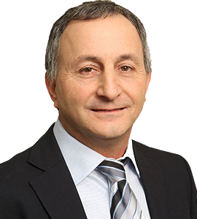
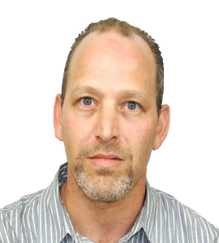
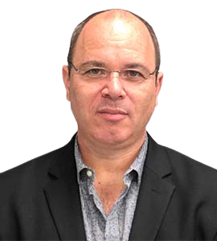
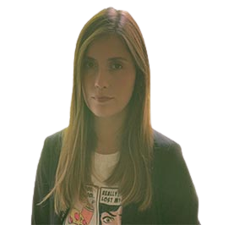
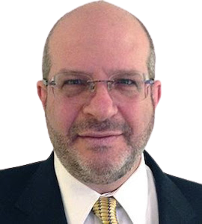
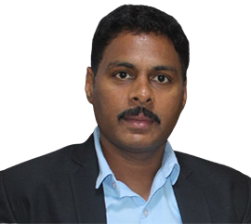
The Team
Hertzel Ozer
Sneer Rosenfeld
Erez Kaplan Haelion
Founder & Chairman of the board
CEO
Founder & CTO
Chairman of the Board of few large companies such as HOT Telecommunication System
Well-experienced Manager
Senior Advisor of Microsoft
Tanya Sarel
Guy Tessler
Sai Krishna
COO
USA Business Development VP
Manager - India
HR Recruiter at Check Point Software Technologies
Experience Managing Partner, GOT Group – Atlanta, GA
Founder of Global Cyber Security Forum

Slide 26
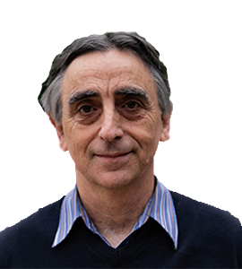
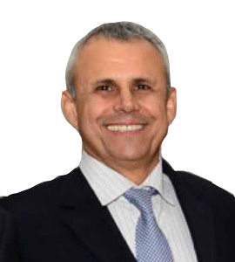
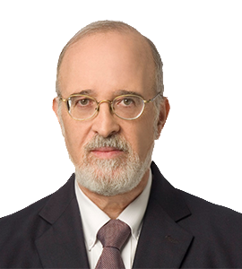
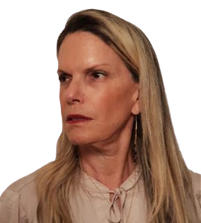
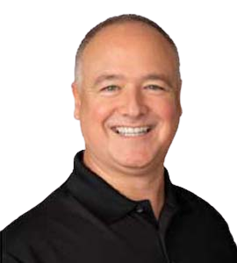
Advisory Board
Professor Lewi Stone, Ph.D. - Advisory Board
Major Gen. (Res.) Yitzhak (Jerry) Gershon
Major Gen. (Res.) Professor Isaac Ben Israel
Advisory Board
Advisory Board
Expert of mathematical modelling of chaotic systems
Chairman of the Israel Airports Authority
Col. (Ret.) Adi Bershadsky
Professor Bryson R. Payne
Advisory Board
The initiator of the National Cyber Authority at the Prime Minister's Office in Israel
Advisory Board
Advisory Board
Former military attaché in Europe
Tenured Professor of Computer Science

Slide 27
Contact Us
www.cyber20.com
info@cyber20.com
+972-77-5438441

